Slide 1
Elasticity and Its Application
CHAPTER 5
Notes:
N. Gregory Mankiw Principles Of Economics Eight Edition

Slide 2
The Elasticity of Demand, Part 1
Elasticity
Measure of the responsiveness of quantity demanded or quantity supplied
To a change in one of its determinants
Price elasticity of demand
How much the quantity demanded of a good responds to a change in the price of that good

Slide 3
The Elasticity of Demand, Part 2
Price elasticity of demand
Percentage change in quantity demanded divided by the percentage change in price
Elastic demand
Quantity demanded responds substantially to changes in price
Inelastic demand
Quantity demanded responds only slightly to changes in price

Slide 4
The Elasticity of Demand, Part 3
Determinants of price elasticity of demand
Availability of close substitutes
Goods with close substitutes: more elastic demand
Necessities versus luxuries
Necessities: inelastic demand
Luxuries: elastic demand

Slide 5
The Elasticity of Demand, Part 4
Determinants of price elasticity of demand
Definition of the market
Narrowly defined markets: more elastic demand
Time horizon
Demand is more elastic over longer time horizons

Slide 6
The Elasticity of Demand, Part 5
Computing the price elasticity of demand
Percentage change in quantity demanded divided by percentage change in price
Use absolute value (drop the minus sign)
Midpoint method
Two points: (Q₁, P₁) and (Q₂, P₂)

Slide 7
The Elasticity of Demand, Part 6
Variety of demand curves
Demand is elastic
Price elasticity of demand > 1
Demand is inelastic
Price elasticity of demand < 1
Demand has unit elasticity
Price elasticity of demand = 1

Slide 8
The Elasticity of Demand, Part 7
Variety of demand curves
Demand is perfectly inelastic
Price elasticity of demand = 0
Demand curve is vertical
Demand is perfectly elastic
Price elasticity of demand = infinity
Demand curve is horizontal
The flatter the demand curve
The greater the price elasticity of demand

Slide 9
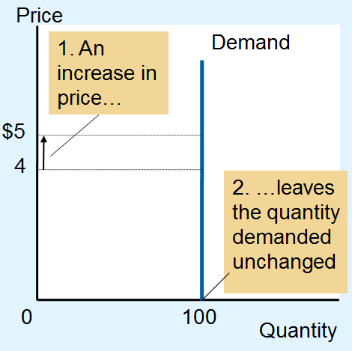
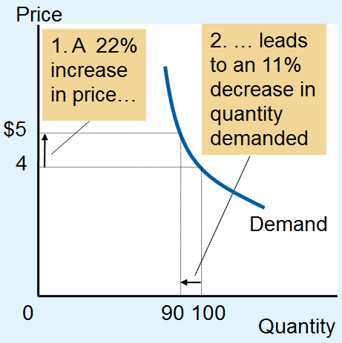
Figure 1 The Price Elasticity of Demand (a, b)
Perfectly Inelastic Demand:
Elasticity Equals 0
(b) Inelastic Demand: Elasticity Is Less Than 1
The price elasticity of demand determines whether the demand curve is steep or flat.
Note that all percentage changes are calculated using the midpoint method.

Slide 10
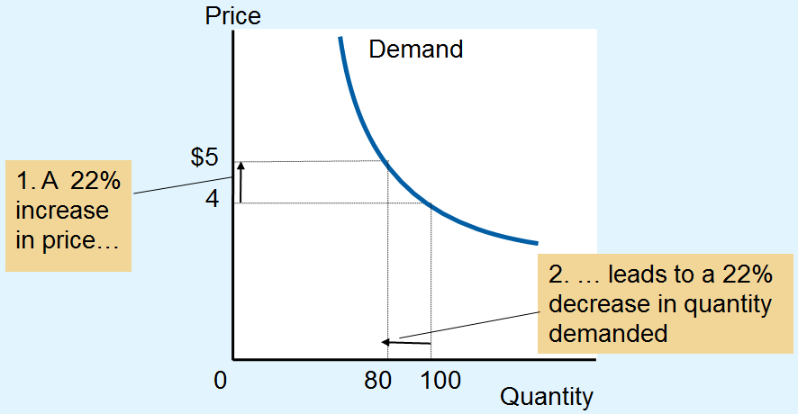
Figure 1 The Price Elasticity of Demand (c)
(c) Unit Elastic Demand: Elasticity Equals 1
The price elasticity of demand determines whether the demand curve is steep or flat.
Note that all percentage changes are calculated using the midpoint method.

Slide 11
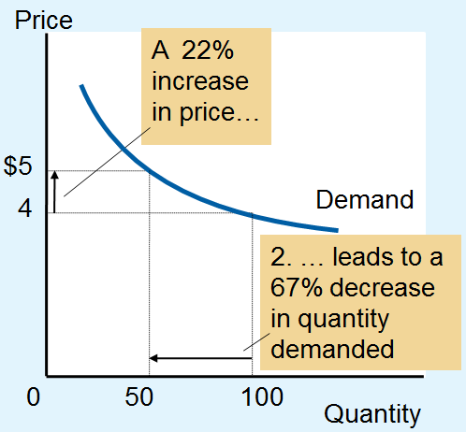
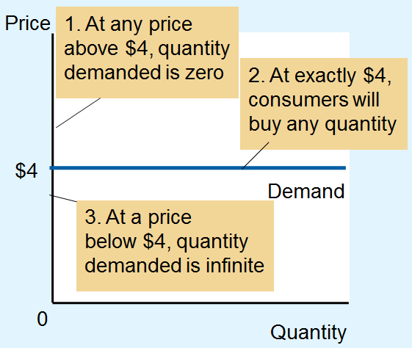
Figure 1 The Price Elasticity of Demand (d, e)
(d) Elastic demand:
Elasticity > 1
(e) Perfectly elastic demand:
Elasticity equals infinity
The price elasticity of demand determines whether the demand curve is steep or flat.
Note that all percentage changes are calculated using the midpoint method.

Slide 12
The Elasticity of Demand, Part 8
Total revenue, TR
Amount paid by buyers and received by sellers of a good
Price of the good times the quantity sold (P × Q)
For a price increase
If demand is inelastic, TR increases
If demand is elastic, TR decreases

Slide 13
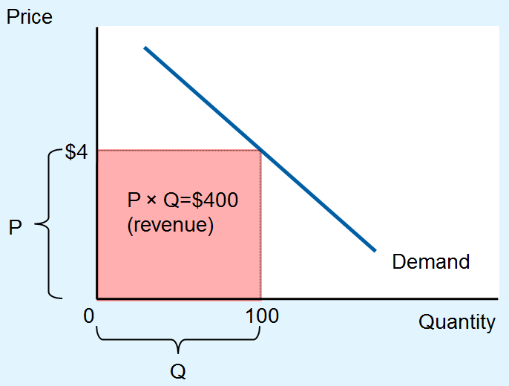
Figure 2 Total Revenue
The total amount paid by buyers, and received as revenue by sellers, equals the area of the box under the demand curve, P × Q.
Here, at a price of $4, the quantity demanded is 100, and total revenue is $400.

Slide 14
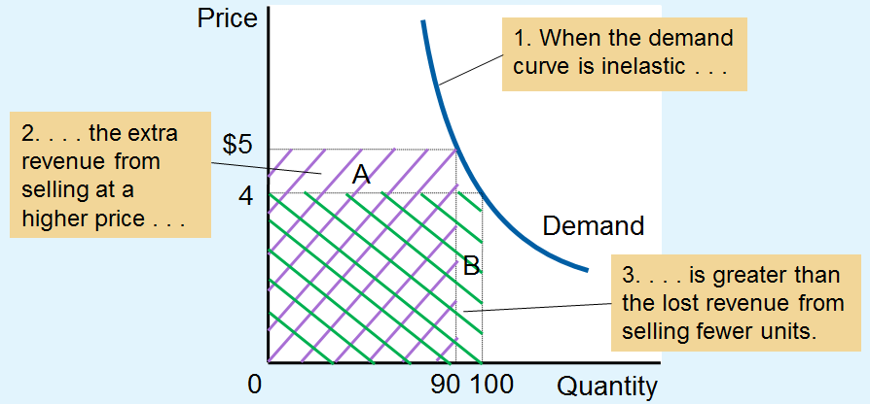
Figure 3 How Total Revenue Changes When Price Changes (a)
(a) The Case of Inelastic Demand
The impact of a price change on total revenue (the product of price and quantity) depends on the elasticity of demand. In panel (a), the demand curve is inelastic.
In this case, an increase in the price leads to a decrease in quantity demanded that is proportionately smaller, so total revenue increases. Here an increase in the price from $4 to $5 causes the quantity demanded to fall from 100 to 90. Total revenue rises from $400 to $450.

Slide 15
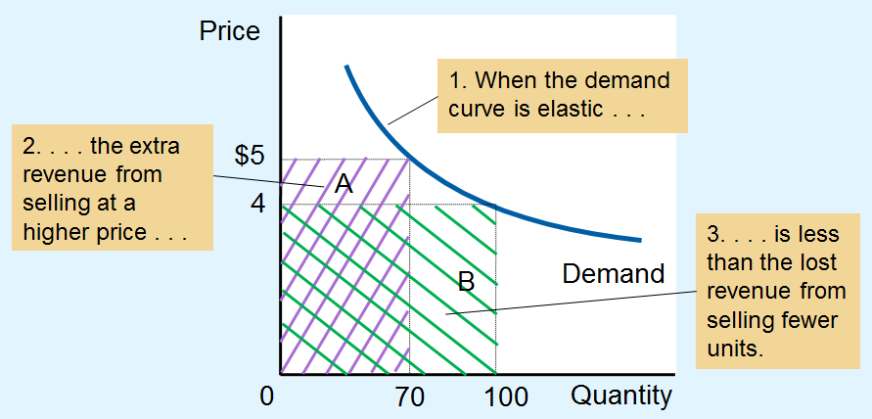
Figure 3 How Total Revenue Changes When Price Changes (b)
(b) The Case of Elastic Demand
The impact of a price change on total revenue (the product of price and quantity) depends on the elasticity of demand. In panel (b), the demand curve is elastic.
In this case, an increase in the price leads to a decrease in quantity demanded that is proportionately larger, so total revenue decreases. Here an increase in the price from $4 to $5 causes the quantity demanded to fall from 100 to 70. Total revenue falls from $400 to $350.

Slide 16
The Elasticity of Demand, Part 9
When demand is inelastic (elasticity < 1)
P and TR move in the same direction
If P ↑, TR also ↑
When demand is elastic (elasticity > 1)
P and TR move in opposite directions
If P ↑, TR ↓
If demand is unit elastic (elasticity = 1)
Total revenue remains constant when the price changes

Slide 17
The Elasticity of Demand, Part 10
Linear demand curve
Constant slope
Rise over run
Different price elasticities
Inelastic demand: points with low price and high quantity
Elastic demand: points with high price and low quantity

Slide 18
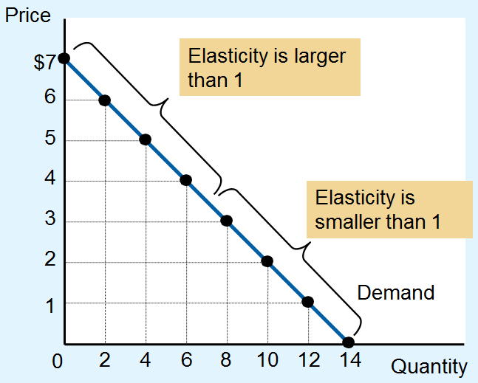
Figure 4 Elasticity along a Linear Demand Curve
The slope of a linear demand curve is constant, but its elasticity is not. The price elasticity of demand is calculated using the demand schedule in the table and the midpoint method.
At points with a low price and high quantity, the demand curve is inelastic.
At points with a high price and low quantity, the demand curve is elastic.

Slide 19
Figure 4 Elasticity along a Linear Demand Curve
Price | Quantity | Total Revenue (Price x Quantity) | Percentage Change in Price | Percentage Change in Quantity | Elasticity | Description
$7 | 0 | $0 | 15 | 200 | 13.0 | Elastic
6 | 2 | 12 | 18 | 67 | 3.7 | Elastic
5 | 4 | 20 | 22 | 40 | 1.8 | Elastic
4 | 6 | 24 | 29 | 29 | 1.0 | Unit elastic
3 | 8 | 24 | 40 | 22 | 0.6 | Inelastic
2 | 10 | 20 | 67 | 18 | 0.3 | Inelastic
1 | 12 | 12 | 200 | 15 | 0.1 | Inelastic
0 | 14 | 0
The slope of a linear demand curve is constant, but its elasticity is not. The price elasticity of demand is calculated using the demand schedule in the table and the midpoint method. At points with a low price and high quantity, the demand curve is inelastic. At points with a high price and low quantity, the demand curve is elastic.

Slide 20
The Elasticity of Demand, Part 11
Income elasticity of demand
How much the quantity demanded of a good responds to a change in consumers’ income
Percentage change in quantity demanded
Divided by the percentage change in income

Slide 21
The Elasticity of Demand, Part 12
Normal goods
Positive income elasticity
Necessities
Smaller income elasticities
Luxuries
Large income elasticities
Inferior goods
Negative income elasticities

Slide 22
The Elasticity of Demand, Part 13
Cross-price elasticity of demand
How much the quantity demanded of one good responds to a change in the price of another good
Percentage change in quantity demanded of the first good
Divided by the percentage change in price of the second good

Slide 23
The Elasticity of Demand, Part 14
Substitutes
Goods typically used in place of one another
Positive cross-price elasticity
Complements
Goods that are typically used together
Negative cross-price elasticity

Slide 24
The Elasticity of Supply, Part 1
Price elasticity of supply
How much the quantity supplied of a good responds to a change in the price of that good
Percentage change in quantity supplied
Divided by the percentage change in price
Depends on the flexibility of sellers to change the amount of the good they produce

Slide 25
The Elasticity of Supply, Part 2
Elastic supply
Quantity supplied responds substantially to changes in the price
Inelastic supply
Quantity supplied responds only slightly to changes in the price
Determinant of price elasticity of supply
Time period
Supply is more elastic in the long run

Slide 26
The Elasticity of Supply, Part 3
Computing price elasticity of supply
Percentage change in quantity supplied divided by percentage change in price
Always positive
Midpoint method
Two points: (Q₁, P₁) and (Q₂, P₂)

Slide 27
The Elasticity of Supply, Part 4
Variety of supply curves
Supply is unit elastic
Price elasticity of supply = 1
Supply is elastic
Price elasticity of supply > 1
Supply is inelastic
Price elasticity of supply < 1

Slide 28
The Elasticity of Supply, Part 5
Variety of supply curves
Supply is perfectly inelastic
Price elasticity of supply = 0
Supply curve is vertical
Supply is perfectly elastic
Price elasticity of supply = infinity
Supply curve is horizontal

Slide 29
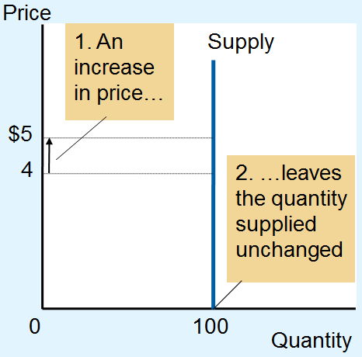
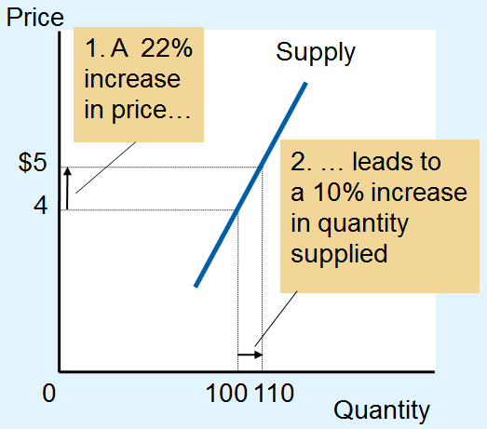
Figure 5 The Price Elasticity of Supply (a, b)
(a) Perfectly Inelastic Supply: Elasticity Equals 0
(b) Inelastic Supply: Elasticity Is Less Than 1
The price elasticity of supply determines whether the supply curve is steep or flat.
Note that all percentage changes are calculated using the midpoint method.

Slide 30
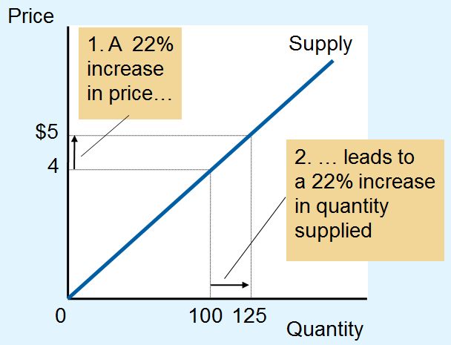
Figure 5 The Price Elasticity of Supply (c)
(c) Unit Elastic Supply: Elasticity Equals 1
The price elasticity of supply determines whether the supply curve is steep or flat.
Note that all percentage changes are calculated using the midpoint method.

Slide 31
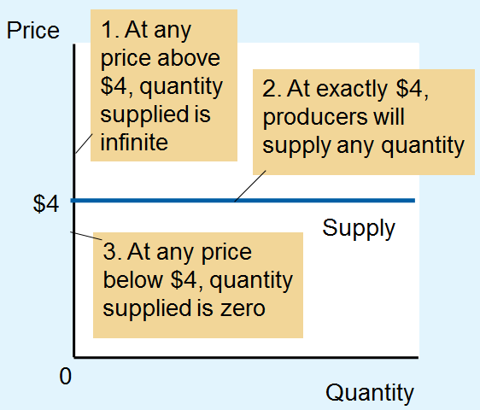
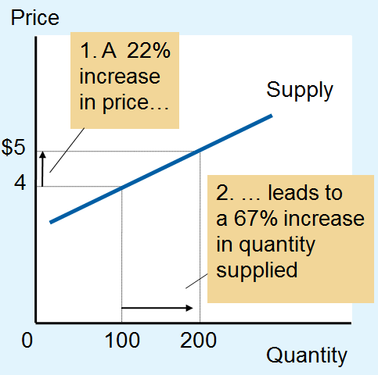
Figure 5 The Price Elasticity of Supply (d, e)
(d) Elastic Supply: Elasticity Is Greater Than 1
(e) Perfectly Elastic Supply: Elasticity Equals Infinity
The price elasticity of supply determines whether the supply curve is steep or flat.
Note that all percentage changes are calculated using the midpoint method.

Slide 32
The Elasticity of Supply, Part 6
Supply curve
Different price elasticities
Points with low price and low quantity
Elastic supply
Capacity for production not being used
Points with high price and high quantity
Inelastic supply

Slide 33
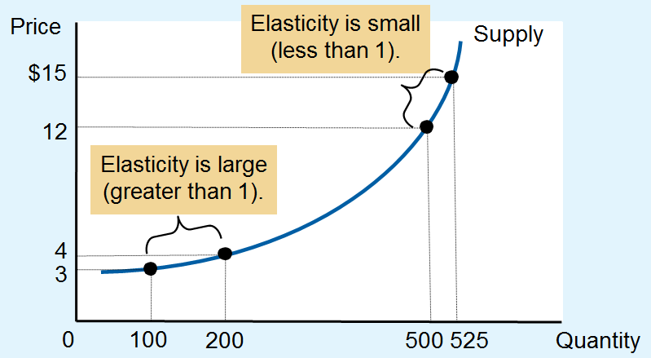
Figure 6 How the Price Elasticity of Supply Can Vary
Because firms often have a maximum capacity for production, the elasticity of supply may be very high at low levels of quantity supplied and very low at high levels of quantity supplied.
Here an increase in price from $3 to $4 increases the quantity supplied from 100 to 200. Because the 67 percent increase in quantity supplied (computed using the midpoint method) is larger than the 29 percent increase in price, the supply curve is elastic in this range.
By contrast, when the price rises from $12 to $15, the quantity supplied rises only from 500 to 525. Because the 5 percent increase in quantity supplied is smaller than the 22 percent increase in price, the supply curve is inelastic in this range.

Slide 34
Three Applications, Part 1
Can Good News for Farming Be Bad News for Farmers?
New hybrid of wheat – increase production per acre by 20%
Supply curve shifts to the right
Higher quantity and lower price
Demand is inelastic: total revenue falls

Slide 35
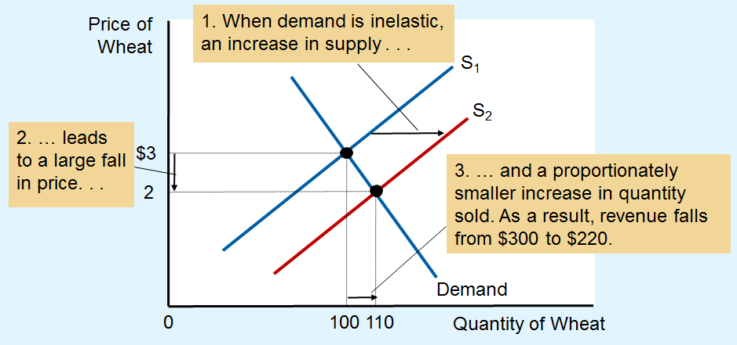
Figure 7 An Increase in Supply in the Market for Wheat
When an advance in farm technology increases the supply of wheat from S₁ to S₂, the price of wheat falls. Because the demand for wheat is inelastic, the increase in the quantity sold from 100 to 110 is proportionately smaller than the decrease in the price from $3 to $2. As a result, farmers’ total revenue falls from $300 ($3 × 100) to $220 ($2 × 110).

Slide 36
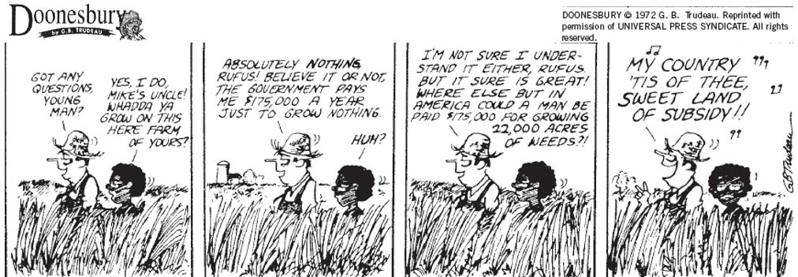
Three Applications, Part 2
Can Good News for Farming Be Bad News for Farmers?
Paradox of public policy
Induce farmers not to plant crops

Slide 37
Three Applications, Part 3
Why Did OPEC Fail to Keep the Price of Oil High?
Increase in prices: 1973 – 1974, 1971 – 1981
Short-run: supply and demand are inelastic
Decrease in supply: large increase in price
Long-run: supply and demand are elastic
Decrease in supply: small increase in price

Slide 38
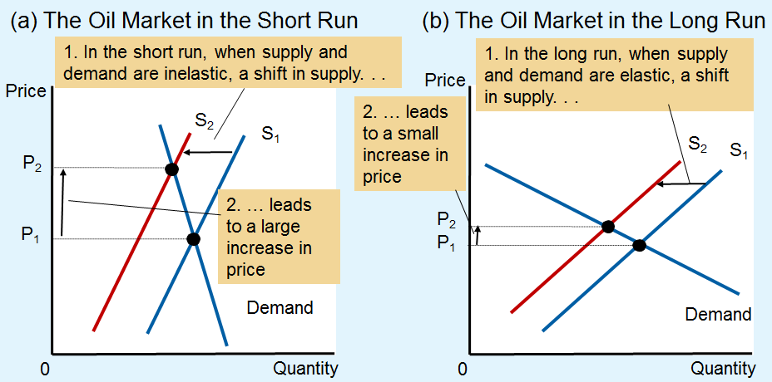
Figure 8 A Reduction in Supply in the World Market for Oil
When the supply of oil falls, the response depends on the time horizon. In the short run, supply and demand are relatively inelastic, as in panel (a). Thus, when the supply curve shifts from S₁ to S₂, the price rises substantially.
In the long run, however, supply and demand are relatively elastic, as in panel (b). In this case, the same size shift in the supply curve (S₁ to S₂) causes a smaller increase in the price.

Slide 39
Three Applications, Part 4
Does Drug Interdiction Increase or Decrease Drug-related Crime?
Increase the number of federal agents devoted to the war on drugs
Illegal drugs: supply curve shifts left
Higher price and lower quantity
Amount of drug-related crimes
Inelastic demand for drugs
Higher drugs price: higher total revenue
Increase drug-related crime

Slide 40
Three Applications, Part 5
Does Drug Interdiction Increase or Decrease Drug-related Crime?
Policy of drug education
Reduce demand for illegal drugs
Left shift of demand curve
Lower quantity
Lower price
Reduce drug-related crime

Slide 41
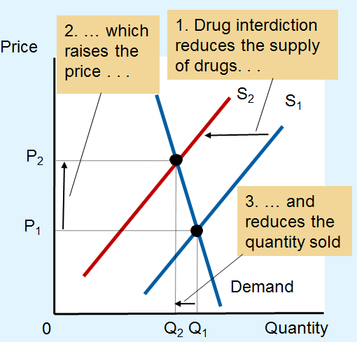
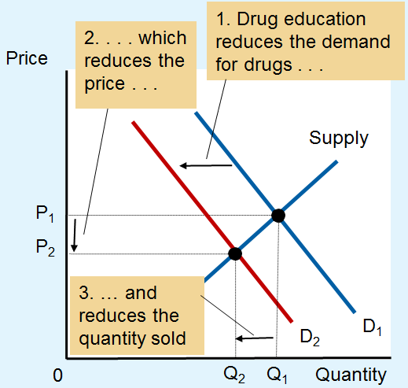
Figure 9 Policies to Reduce the Use of Illegal Drugs
(a) Drug Interdiction
(b) Drug Education
Drug interdiction reduces the supply of drugs from S₁ to S₂, as in panel (a). If the demand for drugs is inelastic, then the total amount paid by drug users rises, even as the amount of drug use falls.
By contrast, drug education reduces the demand for drugs from D₁ to D₂, as in panel (b). Because both price and quantity fall, the amount paid by drug users falls.

